Slide 1



Pizza Dashboard
View in Power BI
Last data refresh:
16/10/2023 17:35:49 UTC
Downloaded at:
09/01/2024 06:24:31 UTC

Slide 2
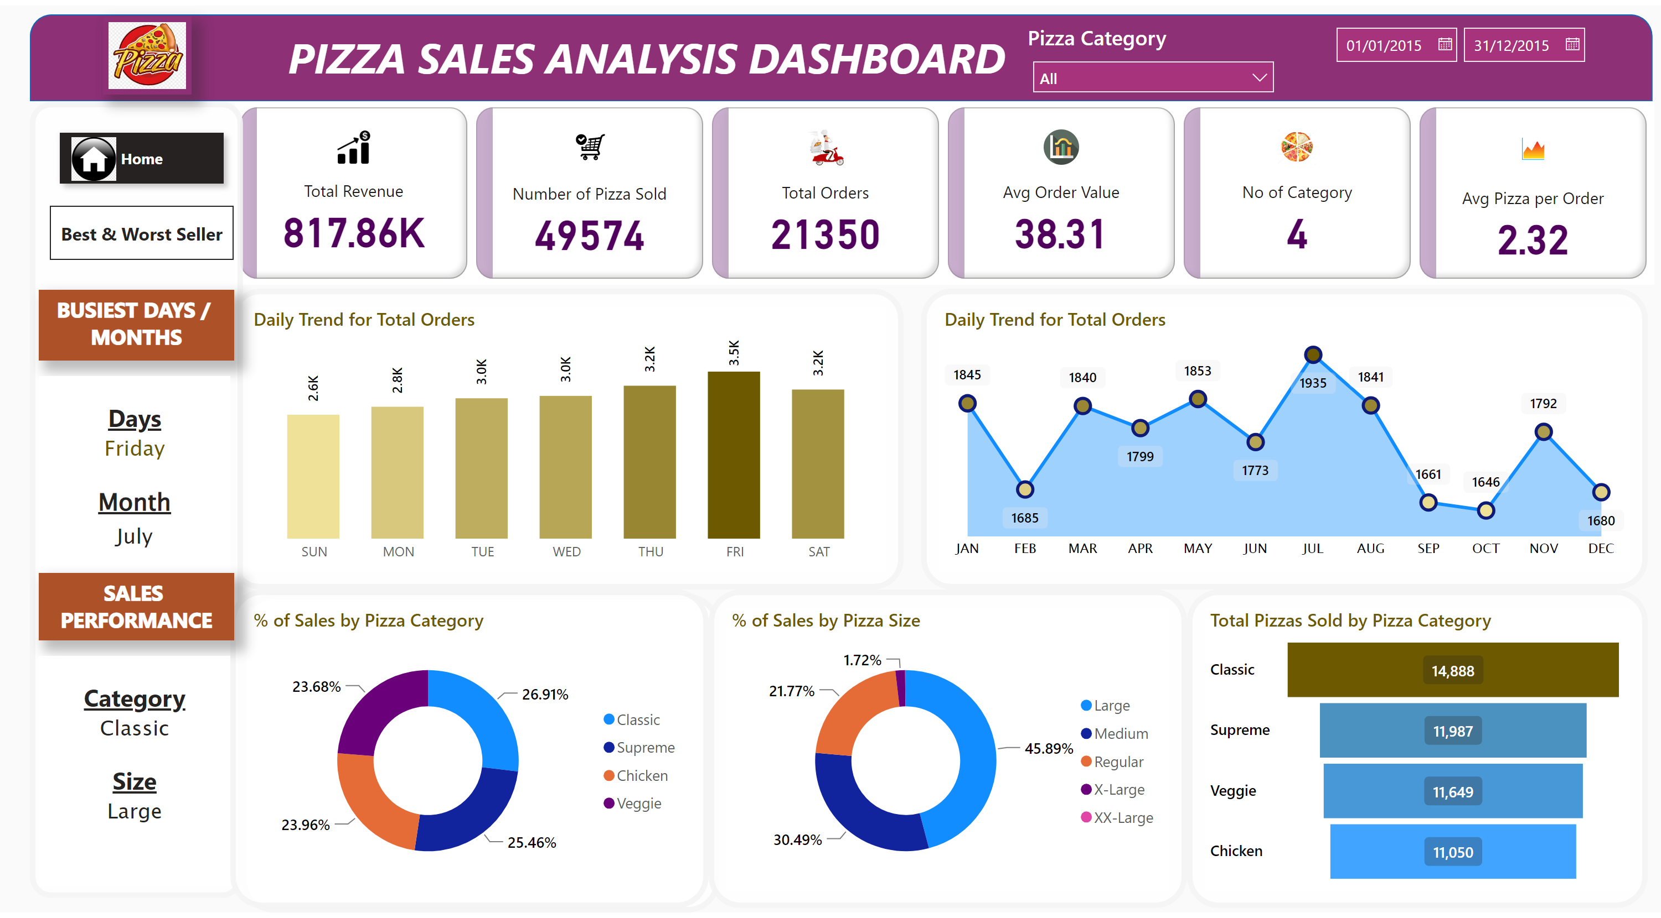
Home
Notes:
cardVisual
No alt text provided
shape
No alt text provided
textbox
No alt text provided
Daily Trend for Total Orders
No alt text provided
Daily Trend for Total Orders
No alt text provided
% of Sales by Pizza Category
No alt text provided
% of Sales by Pizza Size
No alt text provided
Total Pizzas Sold by Pizza Category
No alt text provided
shape
No alt text provided
shape
No alt text provided
shape
No alt text provided
shape
No alt text provided
shape
No alt text provided
shape
No alt text provided
textbox
No alt text provided
textbox
No alt text provided
shape
No alt text provided
textbox
No alt text provided
textbox
No alt text provided
Pizza Category
No alt text provided
Pizza Category
No alt text provided
pageNavigator
No alt text provided
pageNavigator
No alt text provided
image
No alt text provided
image
No alt text provided

Slide 3
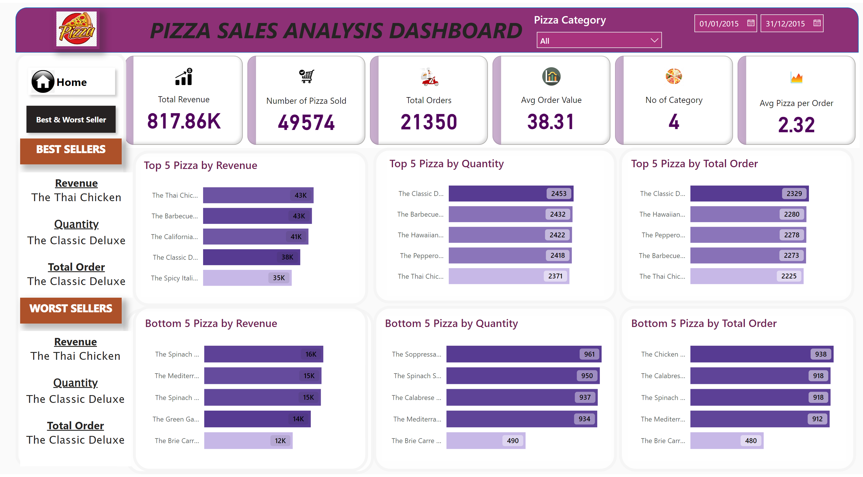
Best & Worst Seller
Notes:
image
No alt text provided
pageNavigator
No alt text provided
pageNavigator
No alt text provided
image
No alt text provided
textbox
No alt text provided
Top 5 Pizza by Quantity
No alt text provided
Bottom 5 Pizza by Revenue
No alt text provided
Top 5 Pizza by Revenue
No alt text provided
shape
No alt text provided
shape
No alt text provided
shape
No alt text provided
Pizza Category
No alt text provided
Pizza Category
No alt text provided
textbox
No alt text provided
shape
No alt text provided
textbox
No alt text provided
textbox
No alt text provided
shape
No alt text provided
shape
No alt text provided
shape
No alt text provided
shape
No alt text provided
textbox
No alt text provided
shape
No alt text provided
cardVisual
No alt text provided
Bottom 5 Pizza by Quantity
No alt text provided
Top 5 Pizza by Total Order
No alt text provided
Bottom 5 Pizza by Total Order
No alt text provided

